Slide 1











Roey Fabian, Ron Sharabi, Amit Cohen, Eran Fishbein
E2EE Platform
Open-source framework
for data collection from
encrypted social networks
Supervisor: Dr. Nir Greenberg

Slide 2







Goal
To develop a platform that enables the collection of private information in
Hebrew from various platforms with
different communication protocols, and
make the platform accessible as open-source

Slide 3





Customers
Researchers
Survey institues

Slide 4


Features
The platform will be able to:
Connect to the customer’s database
Generate a QR code for users to connect their apps
Set up bridges that connect to the different apps
Pull data from the apps into the chosen database
Anonymize the data
The users & costumers will be able to:
Choose which chats they want to share
To manage the bridges and users’ data
To view the users’ data and statistics

Slide 5
?
Social networks and messaging apps in recent years have been restricting access to private and public data
1
The Problem
Integration with various platforms
using different protocols
2
Anonymization in Hebrew – there are no adequate models in the Hebrew language
3

Slide 6

A platform that allows online task distribution
to individuals for payment.
Advantages
Our advantages
Large and diverse user base.
Participants collaborate as it serves as a source of income.
Participants can’t fake the data.
Real-time alerts for disconnections and interruptions.
Automatic anonymization of data.
Quick data retrieval and basic statistical analysis.
Disadvantages
Participants can fake data.
Lacks data processing.
The user doesn’t get “live” data

Slide 7

Collects data from participants' computers, tablets,
and smartphones through an app or browser extension.
Mainly used for internet research.
Advantages
Our advantages
Encrypted data transmission in real-time.
Built-in data processing.
Full flexibility in participant recruitment.
Advanced anonymization methods.
Notifications for disruptions or data-sharing stoppages.
User gets instant data.
Data is taken from platforms with End-to-End Encryption
Disadvantages
Participants only from the US.
Basic anonymization only.
Can’t see data from platforms with End-to-End Encryption
Researchers don’t get instant data.

Slide 8

A platform that collects data from
public sources (e.g., social networks and websites)
without requiring plugins or app installations.
Advantages
Our advantages
Flexible recruitment.
Secure information.
Built-in processing of data from a wide range of public content.
Comprehensive data processing, including metadata and real content.
Enhanced analytical capabilities through private data access.
Customized participant selection tailored to research needs.
Disadvantages
Limited to metadata processing.
Lacks advanced anonymization.

Slide 9




Utilization of the Matrix protocol, which enables connection to various messaging applications and data retrieval from them using bridges
The Process
Reply
A multi-service system ready for deployment in cloud services / on-premises using Kubernetes / Docker.
Reply

Slide 10

User accessibility - development of a web application.
Reply
User anonymization - use of LLMS for anonymization
Reply

Slide 11
Bridge #1
Bridge #n
Matrix Server

Slide 12


Bridge #1
Bridge #n
Matrix Server
Registarion

Slide 13
Bridge #1
Bridge #n
Anonymization
Matrix Server
Administration
Panel
Registarion

Slide 14
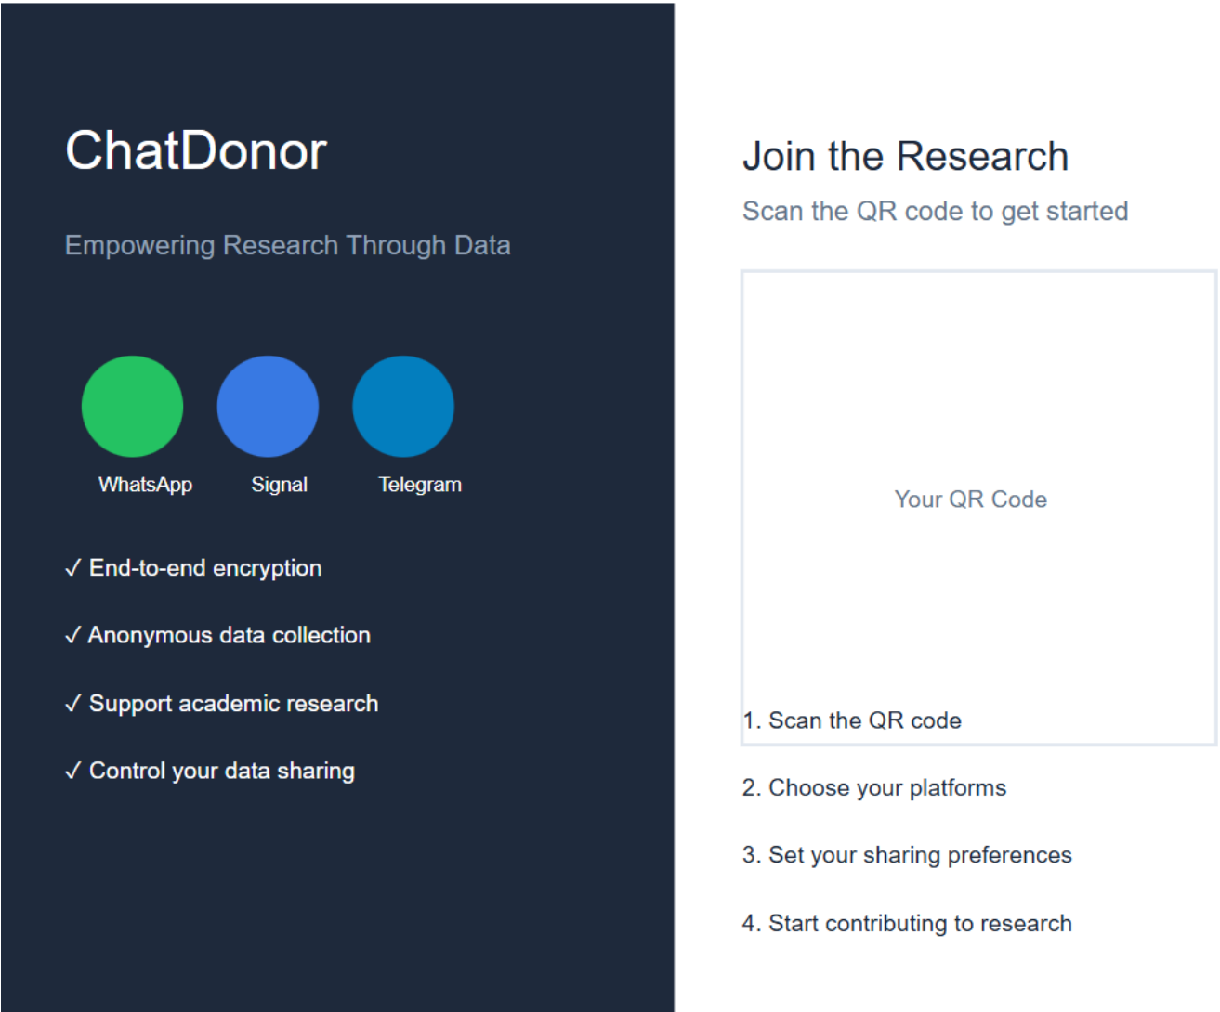

Slide 15
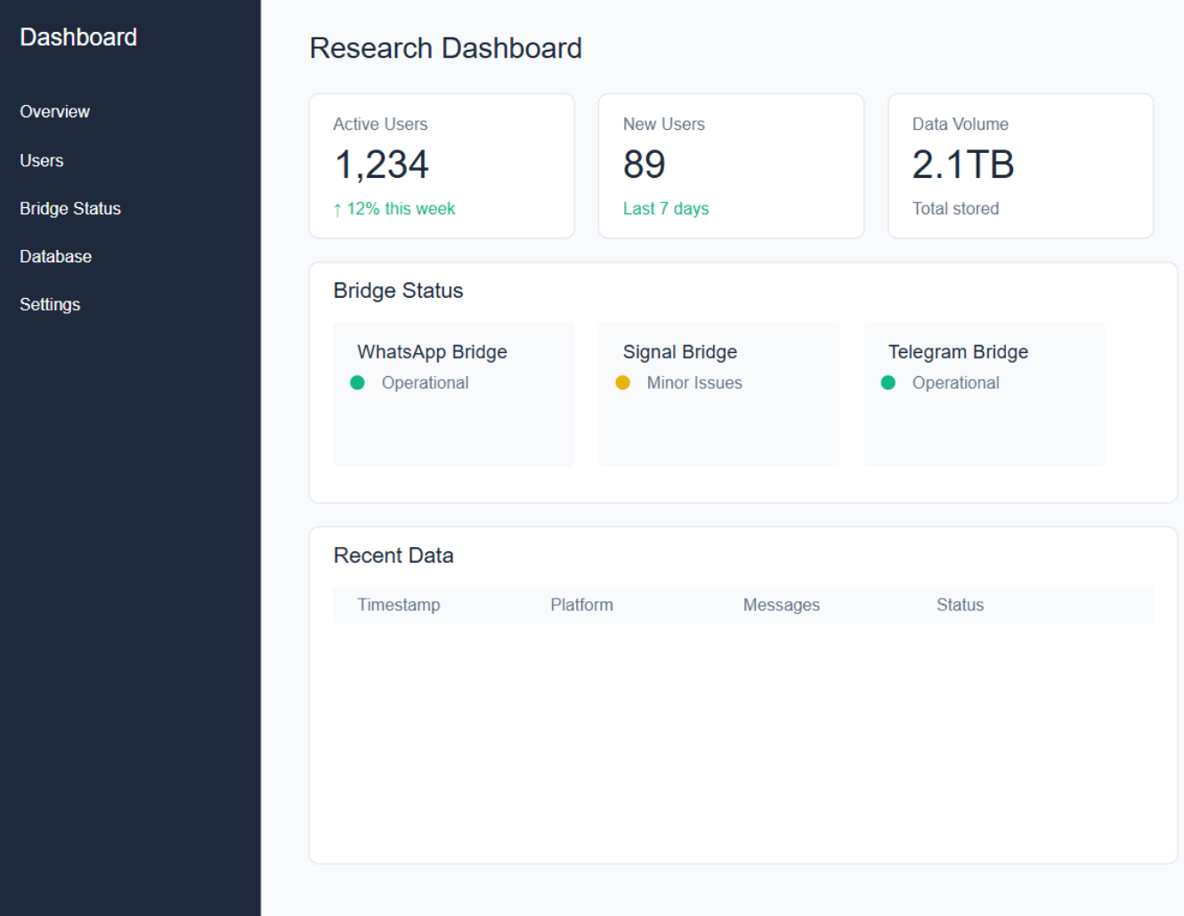

Slide 16


?
Steps
Anonymization
1
Use HeBERT/AlephBERT on whatsapp chats
2
Evaluate the results
3
Train the chosen model on chats using RAG
Notes:
RAG (Retrieval-Augmented Generation) is a framework for enhancing the performance of large language models (LLMs) by integrating external knowledge retrieval with text generation.

Slide 17
Challenges
Adaptation to the Hebrew language
Integration between multiple platforms with different protocols
Anonymization of participants and
prevention of sensitive data leakage
Maintaining data integrity
Preserving the scalability principle in the platform

Slide 18
The Work
So Far
Successful connection of single WhatsApp account to the terminal using whatsmeow, the user’s conversation contacts were available on screen as well as incoming messages
A configuration for a server,
currently the server isn’t connected to bridges

Slide 19

Dec 20: Implementation of Matrix bridge for WhatsApp (single user)
Dec 25: Data processing and database connection
Dec 30: Migration to Kubernetes
DEC24
Road Map
Jan 10: Setting up multiple bridges connecting in parallel to the same database
Jan 10: Expanding support for Telegram and Signal
Jan 16: POC (Proof of Concept) completion
JAN25

Slide 20
Mar 24: Hebrew text anonymization
Mar 28: Integration with authentication service and user management
MAR25
Road Map
APR25
Apr 10: Basic dashboard and web UI implementation
Jun 1: Testing phase
Jun 1: Collaboration with survey company
JUN25

Slide 21


thank you!

